Slide 1

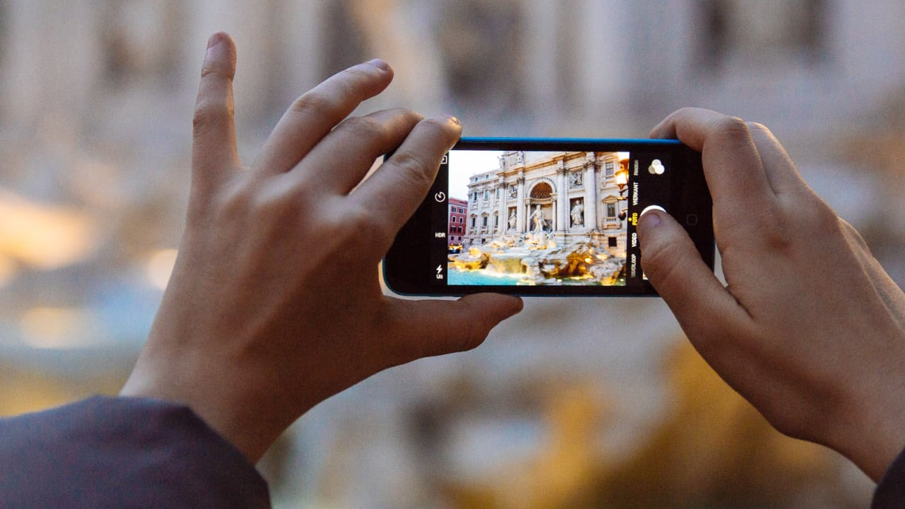
Image Filtering in MATLAB
Submitted By:
Shivam Pathak
Matriculation Number: 27815
System Simulation SS2020
Information Engineering and Computer Science

Slide 2

Agenda
Image and Noise
Noise Reduction via Image Filters
Average Filter vs. Median Filter
Demonstration

Slide 3
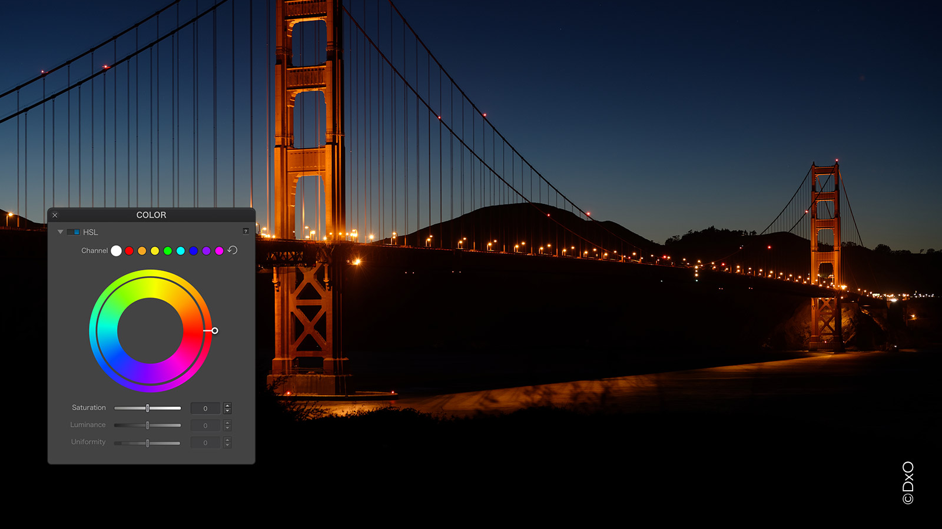
Image
A visual impression of an object.
Capturing devices – Camera, telescope, microscope, etc.
Viewed on computer, mobile device screens, printed in papers.

Slide 4
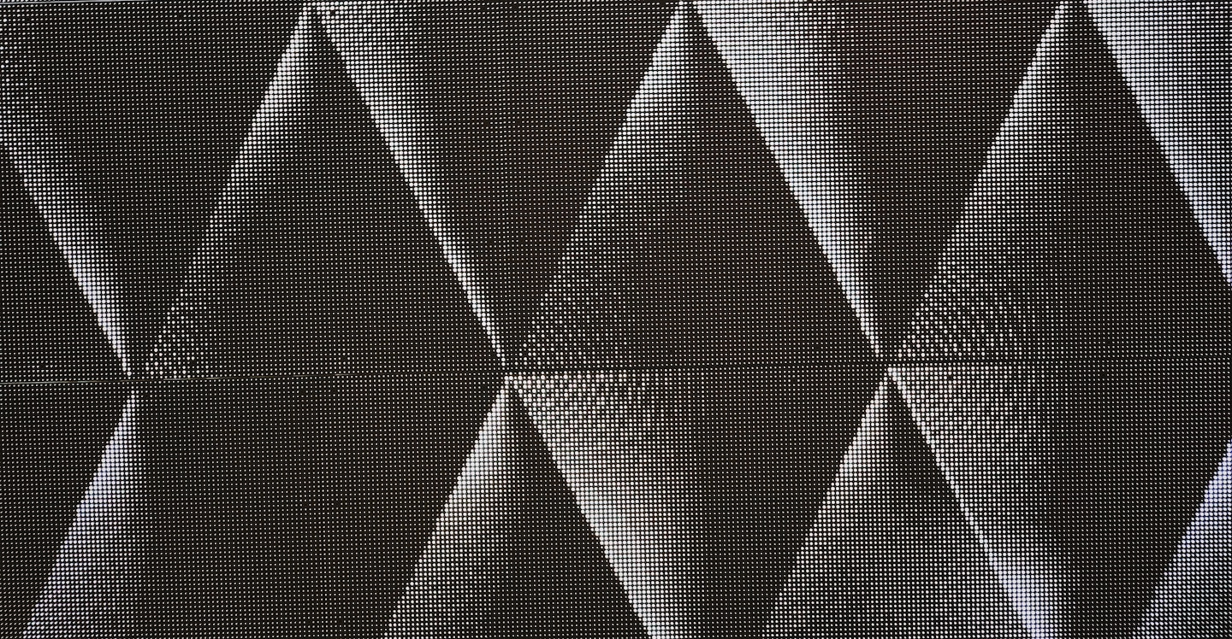
Noise in Image
Degrades the image.
May be introduced during capturing or transmitting the image.
Noise Types:
Salt and Pepper Noise (Impulse)
Poisson Noise (Shot)
Gaussian Noise (Additive)
Speckle Noise (Multiplicative)

Slide 5

Noise Removal
Processing an image through filters to eliminate noise.
Masking an image using Kernel Matrices.
Types of Filtering:
Linear
Non Linear

Slide 6
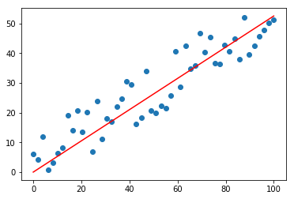
Linear Filters
Convolve the image with a smoothing mask.
The output image is a linear function of the input image.
Fast and easy operation.
Blur the edges and destroy fine details of an image.
Average Filter is an example.
Used theoretically for additive noises.

Slide 7
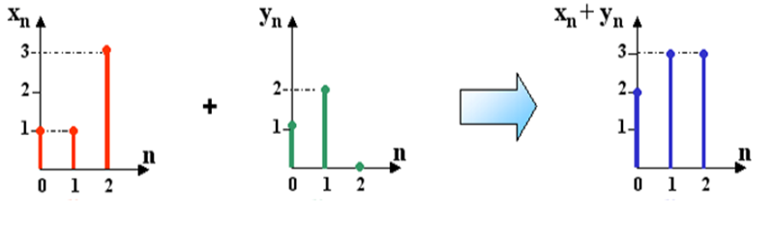
Non Linear Filters
Output image is a non linear function of the input image.
Slower to implement and harder to design.
Image details are preserved.
Median filter is an example.
Used in practical applications.

Slide 8

Average Filter
9X9 Image
3X3 Neighborhood Mask
 | A1 | A2 | A3 | A4 | A5 | A6 | A7 | A8 | A9
B1 | 0 | 0 | 0 | 0 | 30 | 0 | 0 | 0 | 0
B2 | 0 | 0 | 0 | 0 | 0 | 0 | 0 | 0 | 0
B3 | 30 | 30 | 30 | 30 | 30 | 0 | 30 | 30 | 30
B4 | 30 | 30 | 30 | 30 | 30 | 30 | 30 | 30 | 30
B5 | 30 | 30 | 0 | 0 | 0 | 30 | 30 | 30 | 0
B6 | 30 | 30 | 0 | 0 | 0 | 30 | 0 | 0 | 0
B7 | 30 | 30 | 0 | 30 | 0 | 30 | 0 | 0 | 0
B8 | 0 | 30 | 30 | 0 | 30 | 30 | 30 | 30 | 30
B9 | 0 | 0 | 0 | 0 | 0 | 0 | 0 | 0 | 0
1 | 1 | 1
1 | 1 | 1
1 | 1 | 1
1 | 1 | 1
1 | 1 | 1
1 | 1 | 1
10
Mean for Pixel A2B2 (M)=
$$\frac{\begin{aligned} ((1×0)+(1×0)+(1×0)+ \\ (1×0)+(1×0)+(1×0)+ \\ (1×30)+(1×30)+(1×30)) \end{aligned}}{9}$$
M = 90/9 => 10
Replace A2B2 by 10

Slide 9

Median Filter
 | A1 | A2 | A3 | A4 | A5 | A6 | A7 | A8 | A9
B1 | 0 | 0 | 0 | 0 | 30 | 0 | 0 | 0 | 0
B2 | 0 | 0 | 0 | 0 | 0 | 0 | 0 | 0 | 0
B3 | 30 | 30 | 30 | 30 | 30 | 0 | 30 | 30 | 30
B4 | 30 | 30 | 30 | 30 | 30 | 30 | 30 | 30 | 30
B5 | 30 | 30 | 0 | 0 | 0 | 30 | 30 | 30 | 0
B6 | 30 | 30 | 0 | 0 | 0 | 30 | 0 | 0 | 0
B7 | 30 | 30 | 0 | 30 | 0 | 30 | 0 | 0 | 0
B8 | 0 | 30 | 30 | 0 | 30 | 30 | 30 | 30 | 30
B9 | 0 | 0 | 0 | 0 | 0 | 0 | 0 | 0 | 0
Median for Pixel A2B2 (Med)=
$$\{0,0,0,0,0,0,30,30,30\}$$
Med = 0
Replace A2B2 by 0

Slide 10
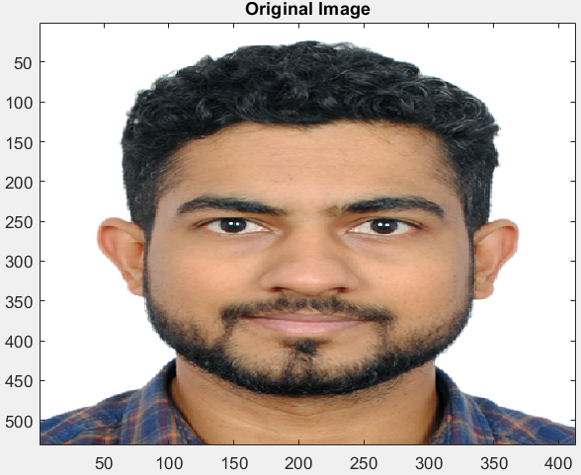
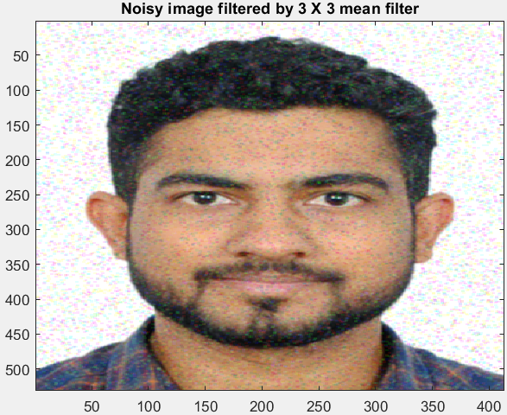
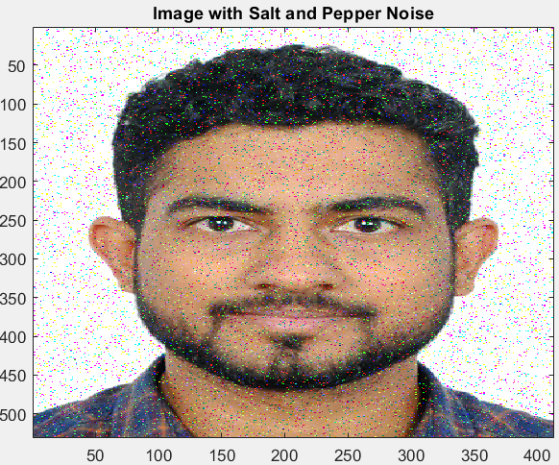
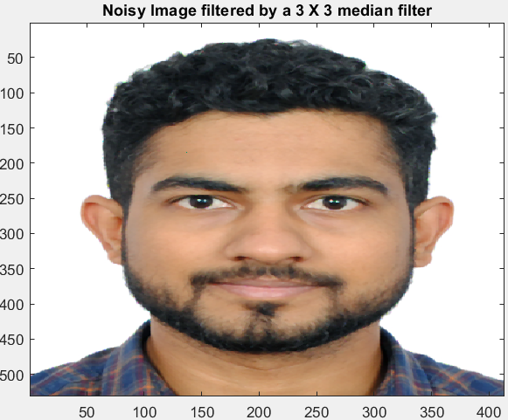
Demonstration
Input – an image corrupted with Salt and Pepper noise.
Output
Image plot from average filter.
Image plot from median filter.

Slide 11
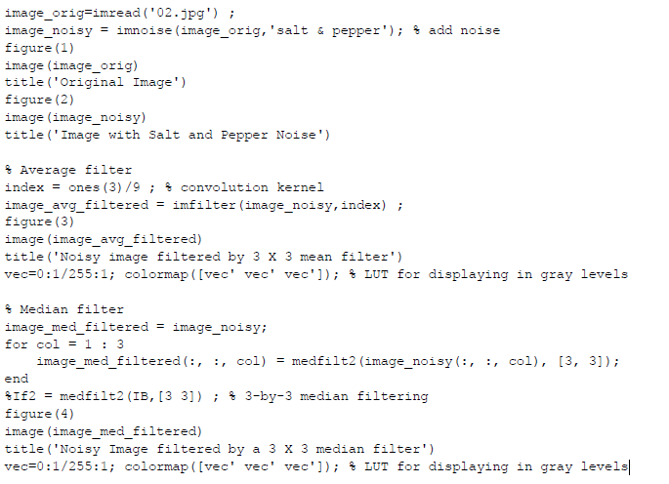
Code

Slide 12
References
Abdalla Mohamed Hambal, D. Z. (2015). Image Noise Reduction and Filtering Techniques. International Journal of Science and Research, 2-6.
Kaur, S. (2015). Noise Types and Various Removal Techniques. International Journal of Advanced Research in Electronics and Communication Engineering (IJARECE), 2-5.

Slide 13

Questions!

